Slide 1
EECS 448: Project 3
“Team One”:
Logan Ayer
Matthew Bauer
James Muoghalu
Luke Weaver

Slide 2
Project Idea
Two-player Checkers game with Server managed games written in Java Swing
Client Application
displays board for each player
validates the piece movements made by the player
removes pieces from the board
Server
will make sure that two players are connected to the game
will handle beginning and ending the game
will communicate changes in the game board to both players

Slide 3
Project Prototype
Functioning Game Mechanics
movement of pieces
showing the valid, available moves
removing of pieces
Missing
game and server/client interface
starting and ending screens

Slide 4
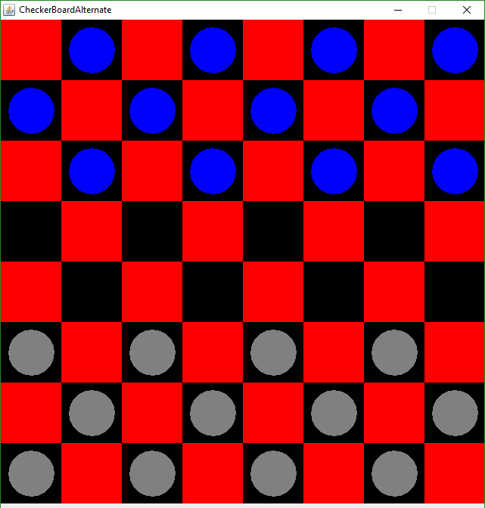
Project Prototype

Slide 5
Division of Labor
Logan
Client/server communication
Matt
game rules, board display, piece movement and removal, Scrum Artifacts
James
board display, piece movement and removal, Scrum Artifacts, presentation
Luke
UML, Game Display

Slide 6
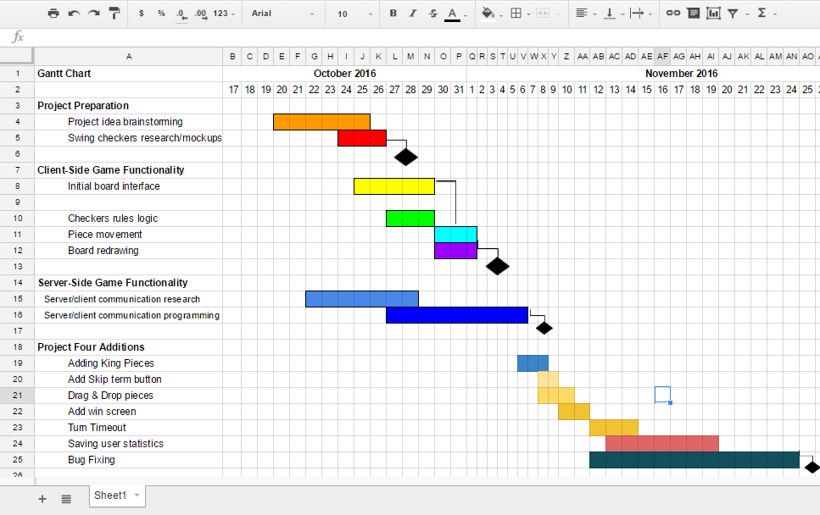
Gantt Chart

Slide 7
Challenges
determining if one of the player’s pieces has been clicked on during that player’s turn
displaying the available moves for a piece based on game rules
being able to redraw the board correctly with each valid movement
determining how to make game compatible with Java networking components

Slide 8
Sources
Java Classes: GraphicsOB, Color
Swing Libraries: JFrame, JPanel, etc.
Java .net
Oracle, YouTube and various tutorials

Slide 9
Potential Additions for Project 4
option to undo moves
dragging and dropping of pieces
animations for piece movement
handling problems with a player’s connection to the server
having user profiles to monitor game stats

